Slide 1

UNIVERSITY INSTITUTE OF ENGINEERING
DEPARTMENT OF COMPUTER SCIENCE & ENGINEERING
Master of Engineering (Computer Science & Engineering)
Subject Name : Soft Computing
Department: CSE
Prepared By: Er. Komal Sharma.
DISCOVER . LEARN . EMPOWER

Slide 2
COURSE DESCRIPTION
Soft Comtuting is everywhere.
An umbrella term used to describe types of algorithms that produce approximate solutions to unsolvable high-level problems in computer science.

Slide 3
COURSE OBJECTIVES
To understand soft computing concepts and techniques
To foster their abilities in designing and implementing soft computing based solutions for real-world and engineering problems.
To Introduce students to fuzzy systems, fuzzy logic and its applications.
To Provide the mathematical background for carrying out the optimization associated with neural network learning.

Slide 4
COURSE OUTCOMES
On completion of this course, the students are expected to have learnt about the following:
C01 | Describe familiarity with the basic concepts related to soft computing
CO2 | Illustrate various fuzzy lgic functions
CO3 | Analyze numerous artificial neural network types
CO4 | Outline fundamental concepts of genetic algorithms in machine learning
CO5 | Develop hybrid nature of FIS techniques to real world problems by extending the capabilities of existing technology

Slide 5
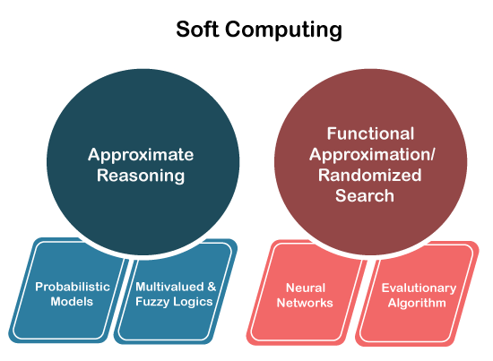
Chapter 1.1.3
Elements of soft computing
Soft computing is the use of approximate
calculations to provide imprecise
but usable solutions to
complex computational problems.
Any problems can be resolved effectively
using these components.
Following are three types of techniques used
by soft computing:
Fuzzy Logic
Artificial Neural Network (ANN)
Genetic Algorithms

Slide 6
Chapter 1.1.3
Fuzzy Logic (FL):
Fuzzy logic is nothing but mathematical logic which tries to solve problems with an open and imprecise spectrum of data. It makes it easy to obtain an array of precise conclusions.
Fuzzy logic is basically designed to achieve the best possible solution to complex problems from all the available information and input data. Fuzzy logics are considered as the best solution finders.

Slide 7
Chapter 1.1.3
Neural Network (ANN)
Neural networks were developed in the 1950s, which helped soft computing to solve real-world problems, which a computer cannot do itself. We all know that a human brain can easily describe real-world conditions, but a computer cannot.
An artificial neural network (ANN) emulates a network of neurons that makes a human brain (means a machine that can think like a human mind). Thereby the computer or a machine can learn things so that they can take decisions like the human brain.
Artificial Neural Networks (ANN) are mutually connected with brain cells and created using regular computing programming. It is like as the human neural system.

Slide 8
Chapter 1.1.3
Genetic Algorithms (GA)
Genetic algorithm is almost based on nature and take all inspirations from it. There is no genetic algorithm that is based on search-based algorithms, which find its roots in natural selection and the concept of genetics.
In addition, a genetic algorithm is a subset of a large branch of computation.

